Slide 1
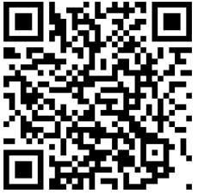
You can be your best here
2025 Marsh Early Career and
Graduate Program
Virtual Open House – Korea
23 April, Wednesday 2025
5pm to 6pm KST
Scan the QR Code to register
Marsh is the world’s leading
insurance broker and risk advisor
A business of Marsh McLennan

